Slide 1

L5 – Exploratory Data Analysis Part 2

Slide 2
Read Carefully
For each week’s in-class exercises and/or homework, please create a new Jupyter notebook file with the following naming convention:
ID_Name_L(no.).ipynb
for example,
6619999_Johnwick_L5.ipynb

Slide 3
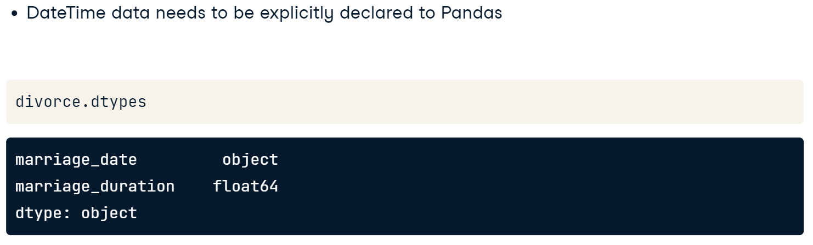
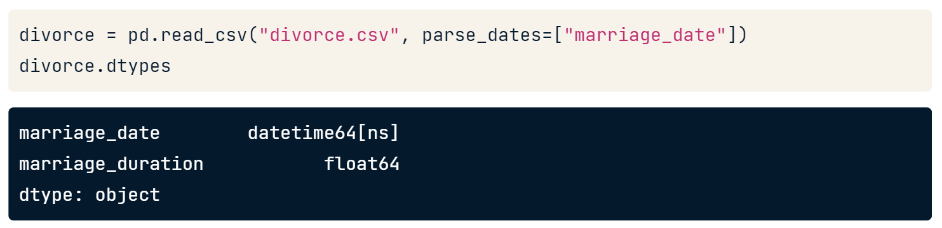
Patterns over Time
Before we can begin to look at potential patterns over time, we need to help pandas understand that data in a given column is, in fact, date or time data. When a CSV file is imported into pandas, date and time data are typically interpreted as strings, as we see here.
We can fix that by adding the parse_dates keyword argument to the CSV import and setting it equal to a list of column names that should be interpreted as DateTime data. Now, when we check the data types of the imported CSV, the indicated column is a DateTime object. This data type opens up many possibilities for analysis, such as looking at patterns over years, months, or even days of the week.

Slide 4
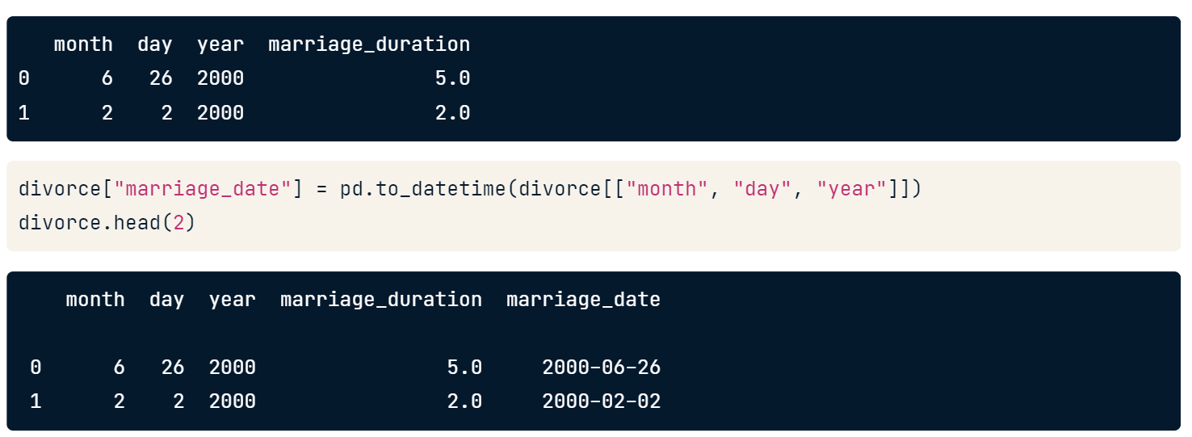
Patterns over Time
Of course, we may wish to update data types to DateTime data after we import the data. This is possible with pd.to_datetime, which converts the argument passed to it to DateTime data. Here, we pass the marriage_date column with values stored as strings to pd.to_datetime. This returns DateTime data which we save as the new marriage_date column.

Slide 5
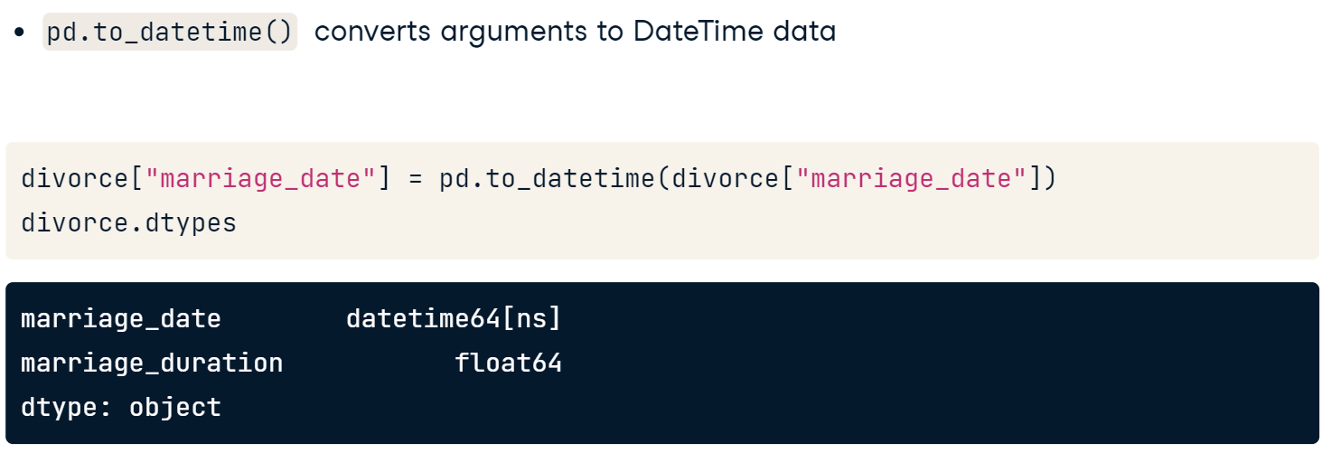
Creating DateTime Data
pd.to_datetime has lots of other useful functionality. For example, if a DataFrame has month, day, and year data stored in three different columns, as this one does, we can combine these columns into a single DateTime value by passing them to pd.to_datetime. Note that for this trick to work, columns must be named "month", "day", and "year", but can appear in any order in the DataFrame.

Slide 6
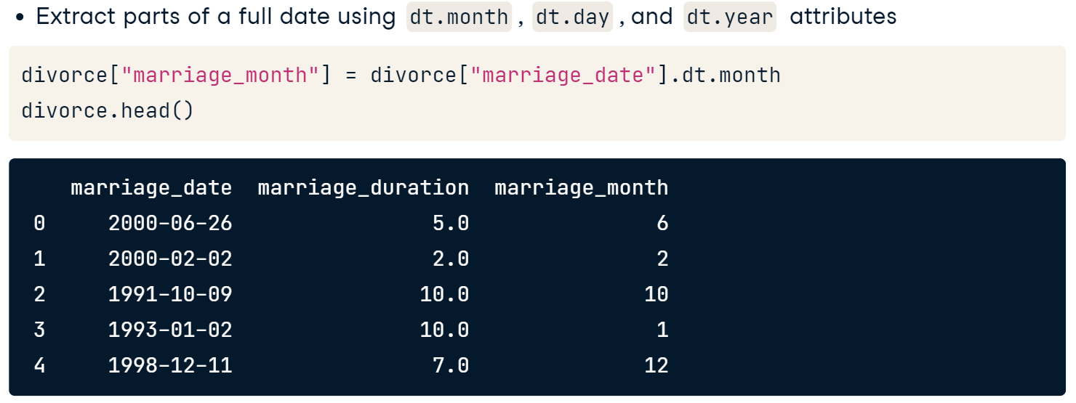
Creating DateTime Data
Conversely, we might want to extract just the month, day, or year from a column containing a full date. If data is already stored in DateTime format, as marriage_date is, we can append .dt.month to extract the month attribute, for example. We'll save the month data as a new column in the DataFrame so that we can use it in our analysis.

Slide 7
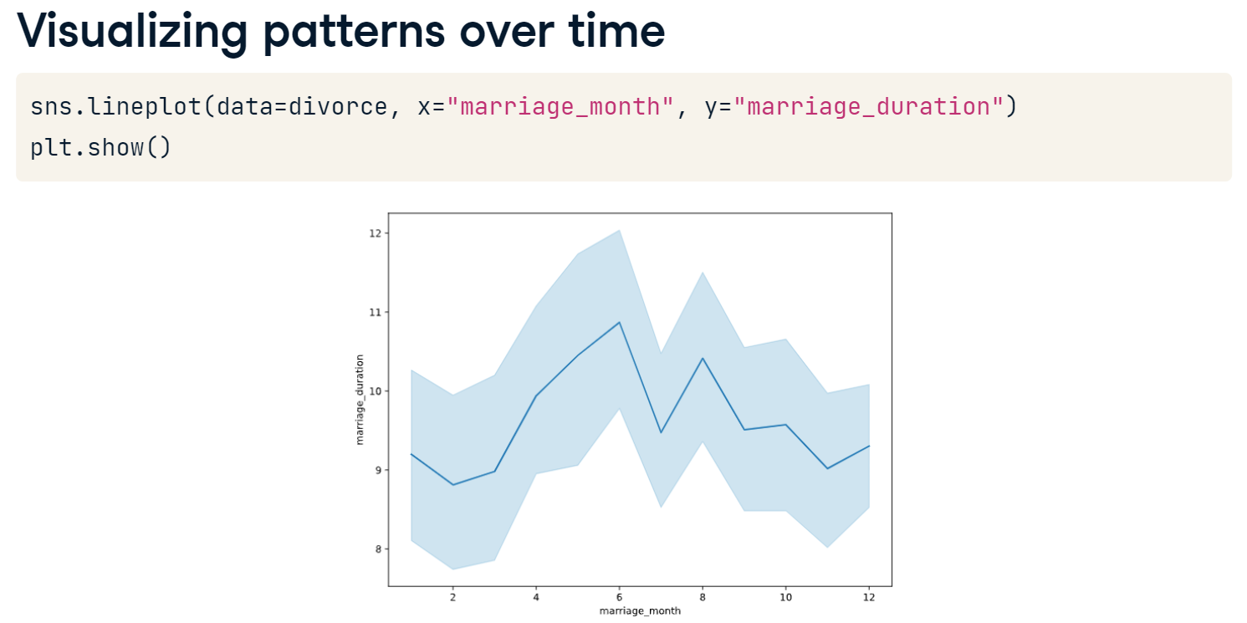
Visualizing DateTime Data
Line plots are a great way to examine relationships between variables. In Seaborn, line plots aggregate y values at each value of x and show the estimated mean and a confidence interval for that estimate. Perhaps we'd like to check whether there is any relationship between the month that a now-divorced couple got married and the length of their marriage. We can set x equal to the marriage_month column and y equal to marriage_duration.
The results show some variation in mean marriage duration between months. The blue line represents the mean marriage duration for our dataset, while the confidence intervals in the lighter blue shading indicate the area that, with 95% probability, the population mean duration could fall between. The wide confidence intervals suggest that further analysis is needed!

Slide 8
Let’s Practice
You'll now work with the entire divorce dataset! The data describes Mexican marriages dissolved between 2000 and 2015. It contains marriage and divorce dates, education level, birthday, income for each partner, and marriage duration, as well as the number of children the couple had at the time of divorce.
1. Import divorce.csv, saving as a DataFrame, divorce; indicate in the import function that the divorce_date, dob_man, and dob_woman, columns should be imported as DateTime values. Check the data types.
Question Which of the columns in the divorce DataFrame has not been updated to a DateTime data type but should be? divorce_date marriage_date. education_woman num_kids
2. Convert the marriage_date column of the divorce DataFrame to DateTime values. Check the data types.
Define a column called marriage_year, which contains just the year portion of the marriage_date column.
Create a line plot showing the average number of kids a couple had during their marriage, arranged by the year that the couple got married.

Slide 9
Correlation
Correlation describes the direction of the relationship between two variables as well as its strength. Understanding this relationship can help us use variables to predict future outcomes. A quick way to see the pairwise correlation of numeric columns in a DataFrame is to use pandas' .corr(numeric_only = True) method.
A negative correlation coefficient indicates that as one variable increases, the other decreases.
A value closer to zero is indicative of a weak relationship,
Values closer to one or negative indicate stronger relationships.
The number varies from -1 to 1. For example,
1 means that there is a 1 to 1 relationship (a perfect correlation), and for this data set, each time a value went up in the first column, the other one went up as well.
0.9 is also a good relationship; if you increase one value, the other will probably increase.
-0.9 would be just as good a relationship as 0.9, but if you increase one value, the other will drop.
0.2 means NOT a good relationship, meaning that if one value goes up does not mean the other will.
Note that .corr() calculates the Pearson correlation coefficient, measuring the linear relationship between two variables.

Slide 10
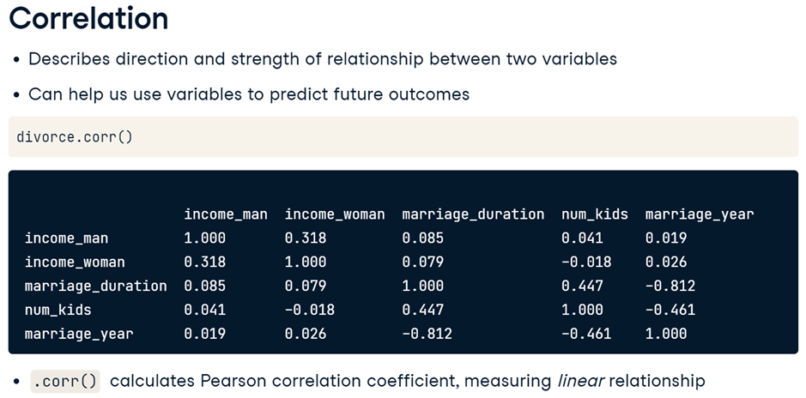
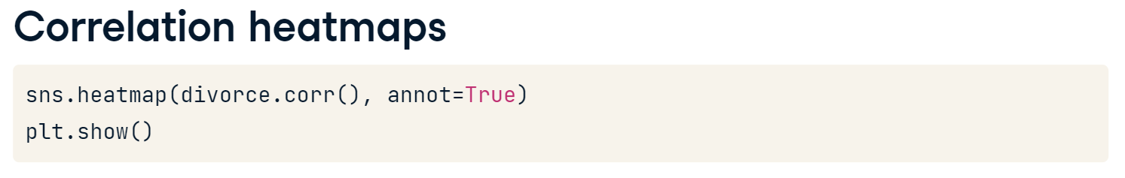
Let's wrap up our divorce.corr() results in a Seaborn heatmap for quick visual interpretation. A heatmap has the benefit of color coding so that strong positive and negative correlations are easier to spot. Setting the annot argument to True labels the correlation coefficient inside each cell. Here, we can see that marriage year and marriage duration are strongly negatively correlated; in this dataset, marriages in later years are typically shorter.
For the latest Pandas version, you may need to pass “numeric_only = True” to .corr()

Slide 11
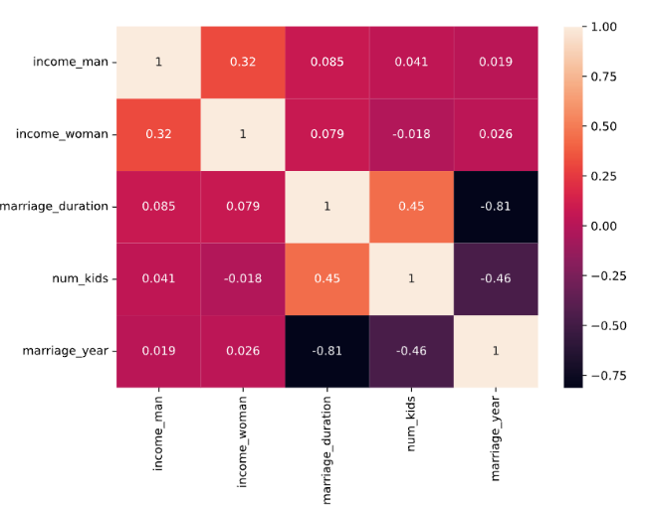
For example, the monthly income of the female partner and the male partner at the time of divorce showed a correlation coefficient of 0.32 in our heatmap. Let's check that this correctly indicates a small positive relationship between the two variables by passing them as x and y arguments to Seaborn's scatterplot function. It looks like the relationship exists but is not particularly strong, just as our heatmap suggested.

Slide 12
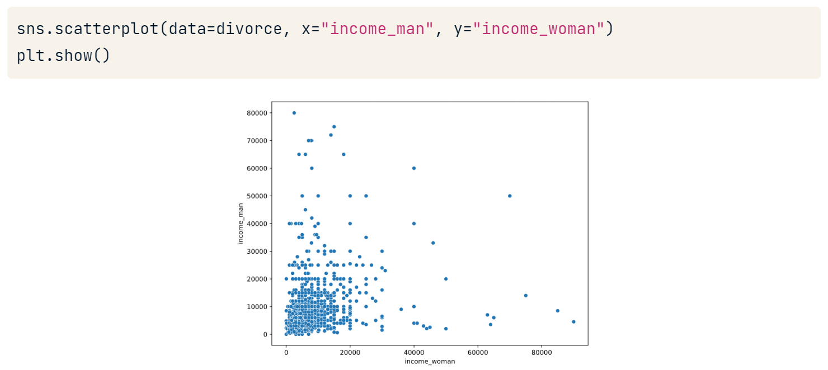

Slide 13
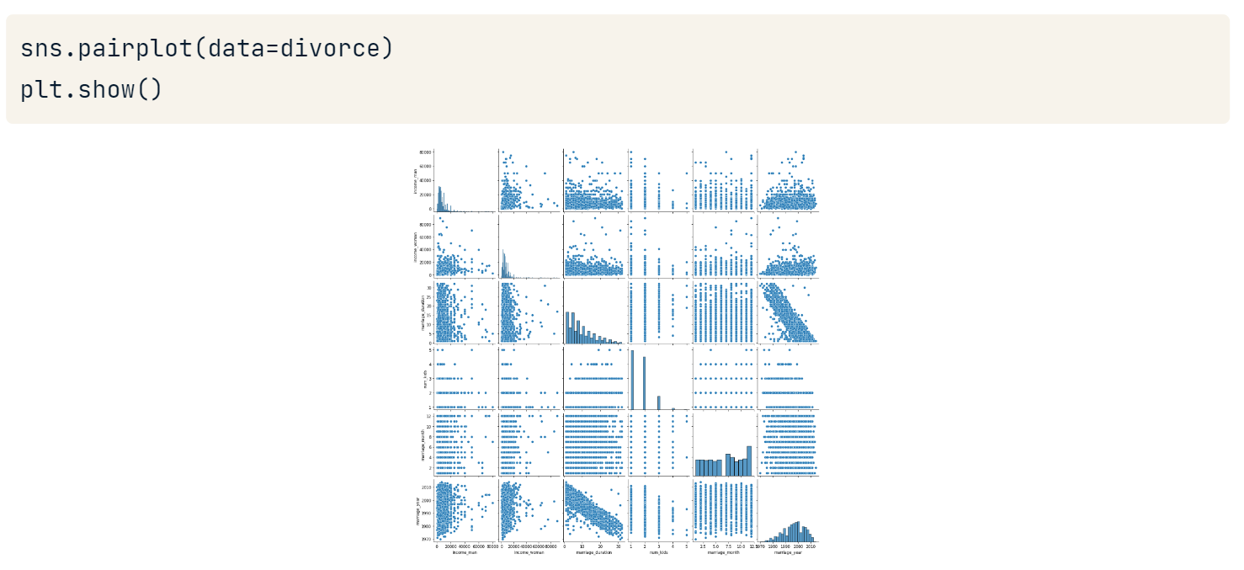
We can take our scatterplots to the next level with Seaborn's pairplot. When passed a DataFrame, pairplot plots all pairwise relationships between numerical variables in one visualization. On the diagonal from upper left to lower right, we see the distribution of each variable's observations. This is useful for a quick overview of relationships within the dataset. However, having this much information in one visual can be difficult to interpret, especially with big datasets which lead to very small plot labels like the ones we see here.

Slide 14
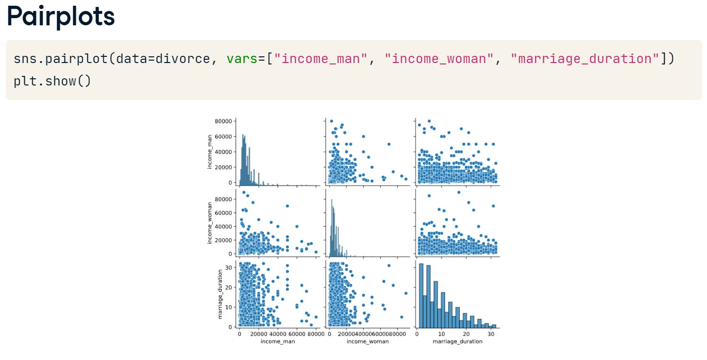
We can limit the number of plotted relationships by setting the vars argument equal to the variables of interest. This visual reassures us that what our correlation coefficients told us was true: variables representing the income of each partner as well as the marriage duration variable all have fairly weak relationships with each other. We also notice in the lower right plot that the distribution of marriage durations includes many shorter marriages and fewer longer marriages.

Slide 15
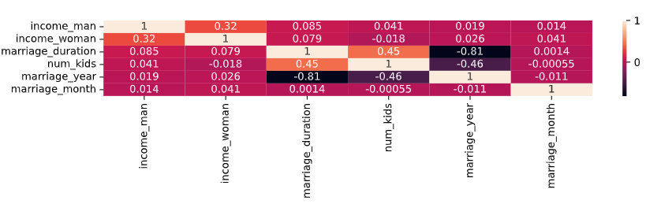
Let’s Practice
According to the following relationships between variables in the divorce DataFrame, which is the possible correct answer?
marriage_duration is strongly positively correlated with marriage_month
The correlation between num_kids and income_man is stronger than the correlation between num_kids and marriage_duration.
A later marriage_year causes a lower number of children, represented by num_kids.
A later marriage_year is correlated with having fewer children.

Slide 16
Let’s Practice
In the last exercise, you may have noticed that a longer marriage_duration is correlated with having more children, represented by the num_kids column. The correlation coefficient between the marriage_duration and num_kids variables is approximately 0.45.
3. Create a scatterplot showing marriage_duration on the x-axis and num_kids on the y-axis.
****There is a slight positive relationship in your scatterplot. In the dataset, couples with no children have no value in the num_kids column. If you are confident that all or most of the missing values in num_kids are related to couples without children, you could consider updating these values to 0, which might increase the correlation.
4. Create a pairplot to visualize the relationships between income_woman and marriage_duration in the divorce DataFrame.
****you can see that the relationship between income_woman and marriage_duration is not a strong one. You can also get a sense of the distributions of both variables in the upper left and lower right plots.

Slide 17
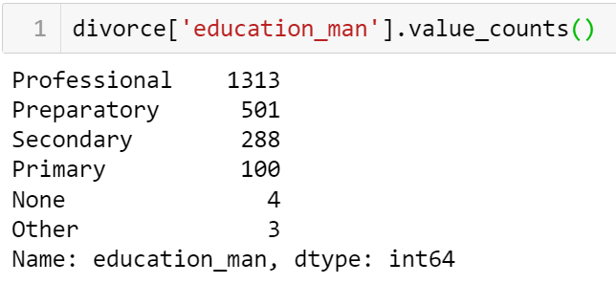
Categorial Relationships
We haven't explored the categorical variables related to education level yet. Let's do it! Checking the value_counts for education_man, we see that most men have an education level between primary and professional, with a few men in the "None" or "Other" categories.

Slide 18
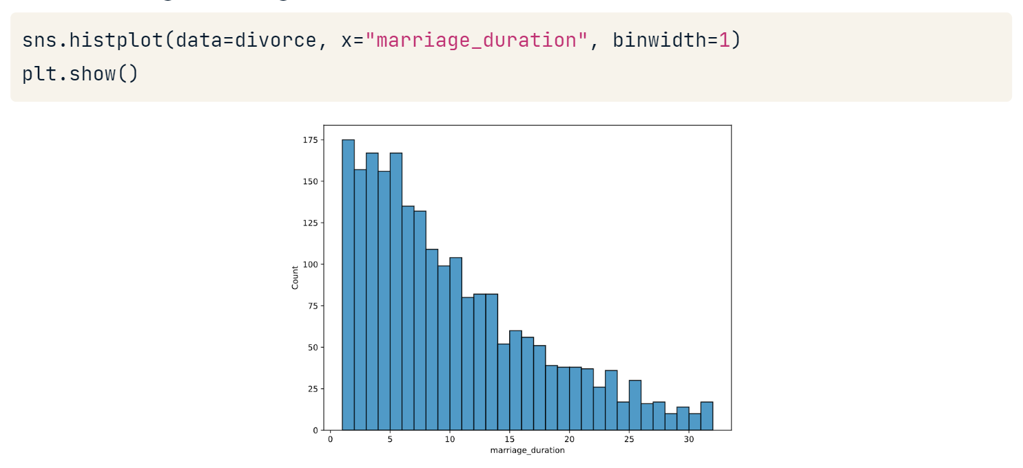
Categorial Relationships
Categorical variables are harder to summarize numerically, so we often rely on visualizations to explore their relationships. Perhaps we are interested in the relationship between marriage duration and the education level of the man in the dissolved marriage. We could begin by making a histogram of the distribution of marriage duration.

Slide 19
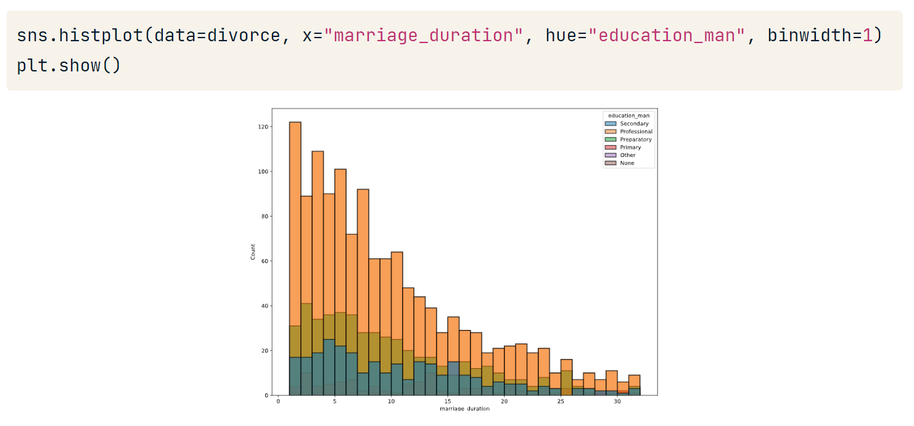
Categorial Relationships
Then layer in the information we have on male education level by setting education_man as the hue argument.
However, because the education levels are stacked on top of each other, the relationship between marriage duration and male education level isn't super clear.

Slide 20
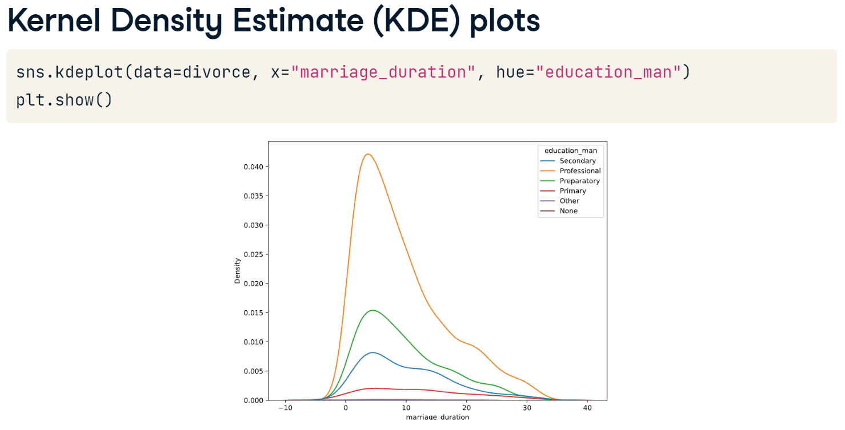
Seaborn KDE Plots
Seaborn's Kernel Density Estimate or KDE plots address the previous issue (unclear visualization due to stacking data). Similar to histograms, KDEs allow us to visualize distributions. However, KDEs are considered more interpretable, especially when multiple distributions are shown as they are here. Notice that the location of the peak marriage duration for each level of the male partner's education is more identifiable in this KDE plot than it was in the histogram. However, due to the smoothing algorithm used in KDE plots, the curve can include values that don't make sense, so it's important to set good smoothing parameters.

Slide 21
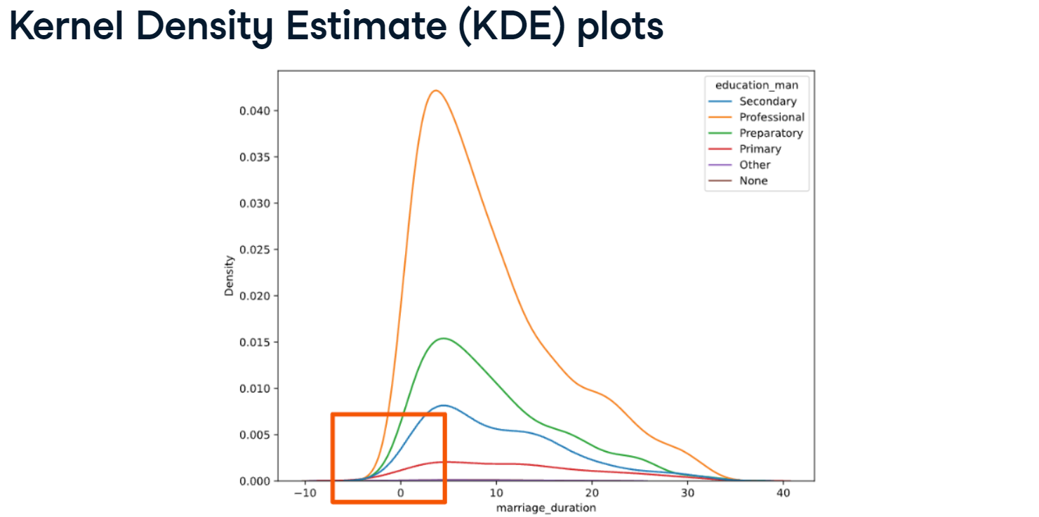
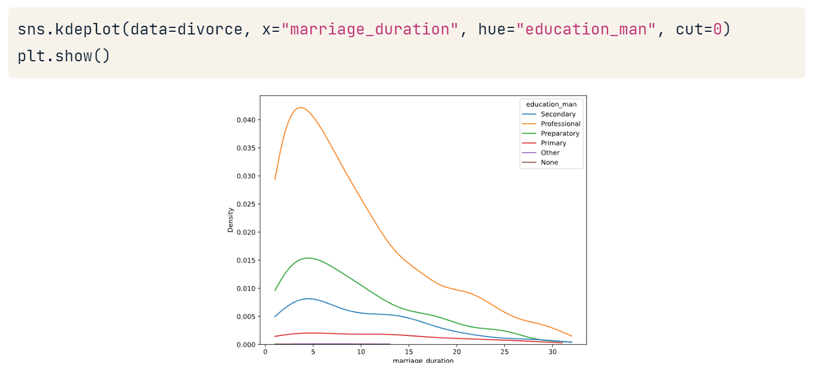
Here's an example: zooming in on the KDE plot showing the distribution of male education levels, we can see that the distribution seems to suggest that some couples had marriage durations of less than zero. That's impossible! (left figure)
To fix this, we can use the cut keyword argument. cut tells Seaborn how far past the minimum and maximum data values the curve should go when smoothing is applied. When we set cut equal to zero, the curve will be limited to values between the minimum and maximum x values, (right figure)
If you get a warning message “…. Convert to a numpy array before indexing instead”, try
sns.kdeplot(data=divorce, x=divorce['marriage_duration'], hue = divorce['education_man'], cut = 0)

Slide 22
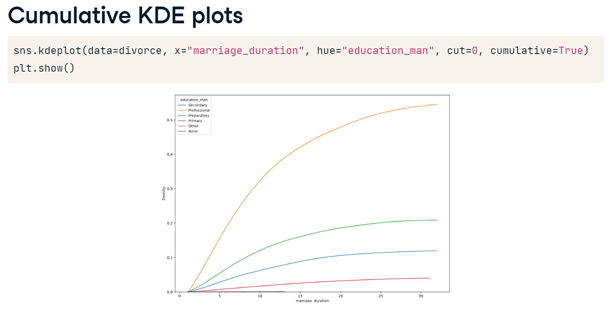
If we're interested in the cumulative distribution function, we can set the cumulative keyword argument to True. This graph describes the probability that marriage duration is less than or equal to the value on the x-axis for each level of male partner education.

Slide 23
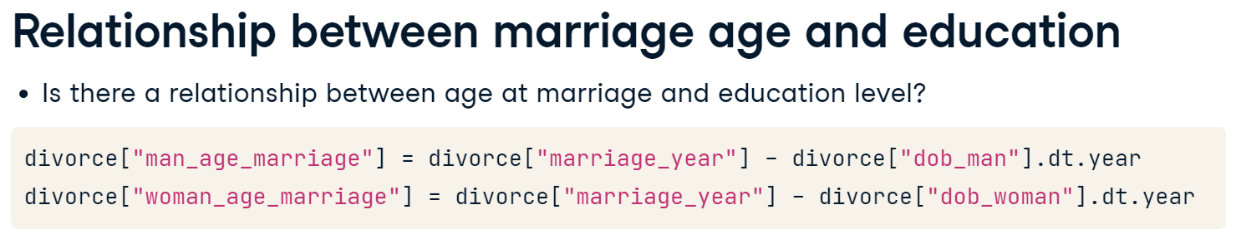
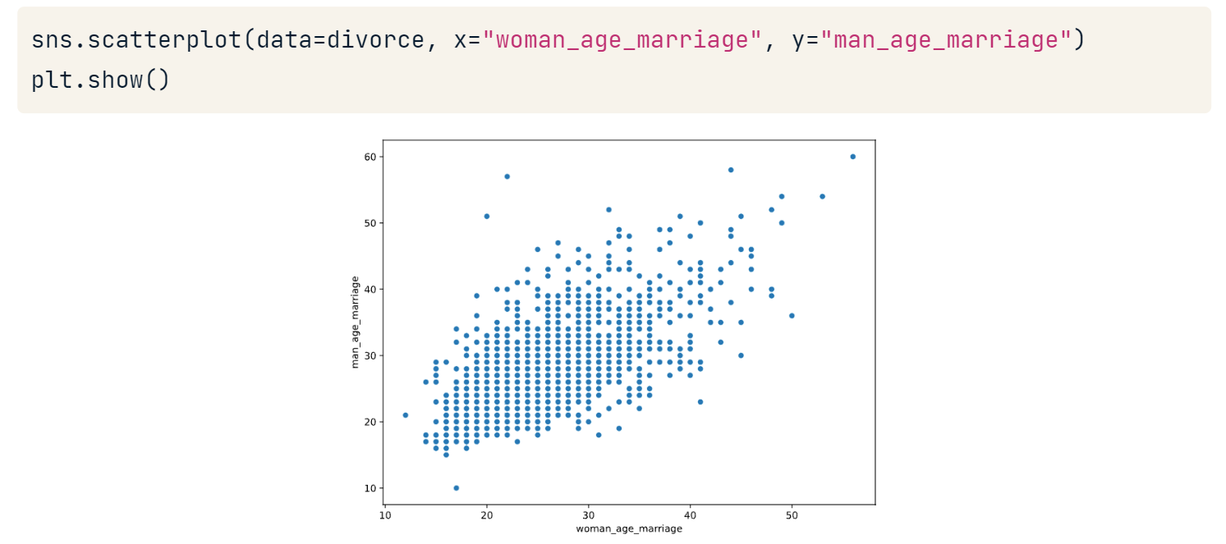
Perhaps we are interested in whether divorced couples who got married when they were older typically have higher levels of education. We can create columns representing the approximate age at marriage for men and women by subtracting each partner's birth year from the marriage year.
Then, we create a scatterplot using these variables on the x and y-axis. It looks like there is a positive correlation between them!

Slide 24
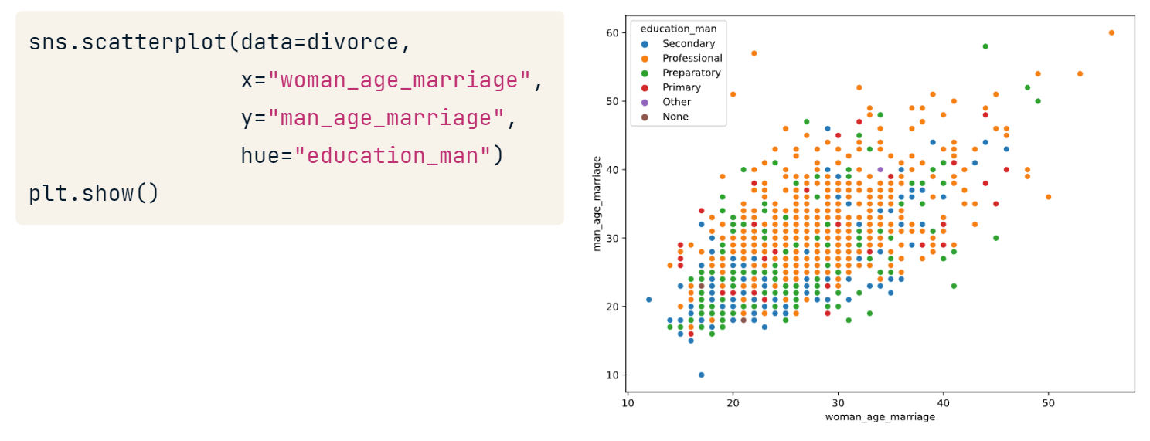
The results suggest that men with a professional education level, represented with orange dots, may tend to get married later.

Slide 25
Let’s Practice
5. Create a scatter plot that shows woman_age_marriage on the x-axis and income_woman on the y-axis; each data point should be colored based on the woman's level of education, represented by education_woman.
Note: From the graph, it looks like there is a positive correlation between professional education and higher salaries, as you might expect. The relationship between women's age at marriage and education level is a little less clear.
6. Create a KDE plot that shows marriage_duration on the x-axis and a different colored line for each possible number of children that a couple might have, represented by num_kids.
Notice that the plot currently shows marriage durations less than zero; update the KDE plot so that marriage duration cannot be smoothed past the extreme data points.
Update the code for the KDE plot from the previous step to show a cumulative distribution function for each number of children a couple has.
Note: It looks as though there is a positive correlation between longer marriages and more children, but of course, this doesn't indicate causation. You can also see that there is much less data on couples with more than two children; this helps us understand how reliable our findings are.

Slide 26
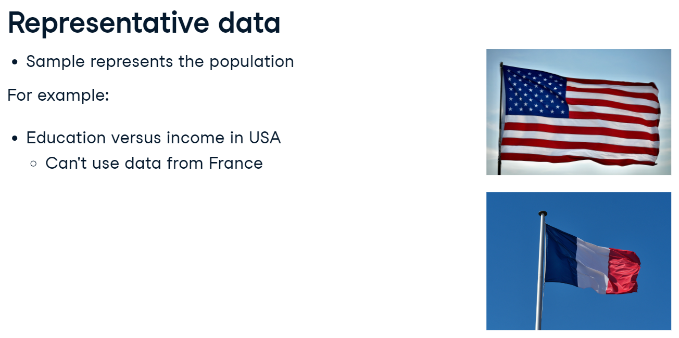
Considerations for Categorial Data
Let's see how we convert exploratory data analysis into action! We'll start by looking at class frequencies.
Recall that EDA is performed for a variety of reasons, like
detecting patterns and relationships in data,
generating questions or hypotheses, or
preparing data for machine learning models.

Slide 27
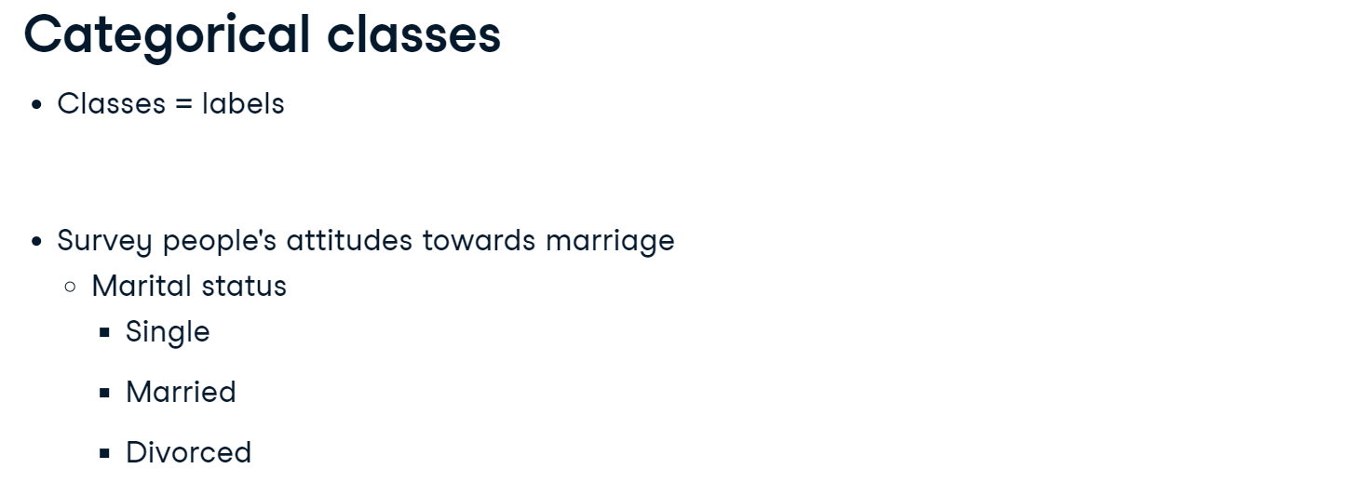
Considerations for Categorial Data
With categorical data, one of the most important considerations is the representation of classes, which is another term for labels. For example, say we collect data on people's attitudes to marriage. As part of our data collection, we find out their marital status, with the classes including single, married, and divorced.
When we performed EDA, we realized only 50 people were married, 700 were divorced, and the remaining 250 were single.
Do we think that this sample accurately represents the general public's opinion about marriage? Are divorced people more likely to have a negative view of marriage? This is an example of class imbalance, where one class occurs more frequently than others. This can bias results, particularly if this class does not occur more frequently in the population.

Slide 28
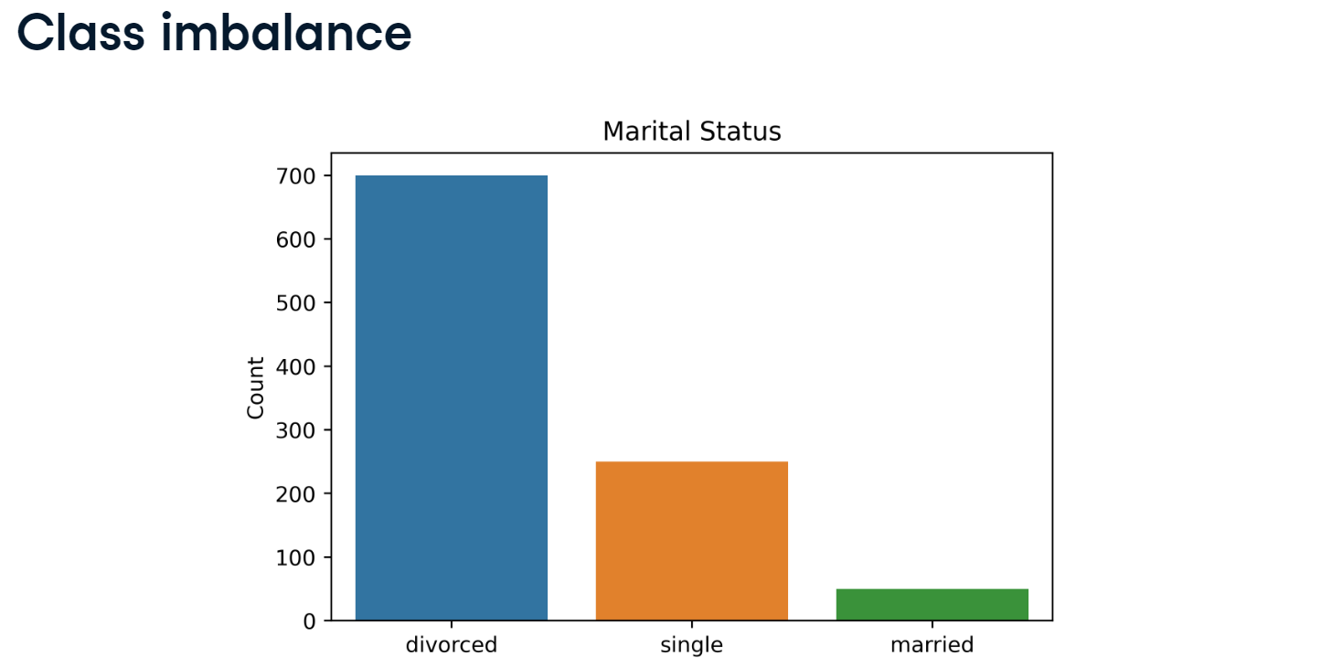
Class Imbalance

Slide 29
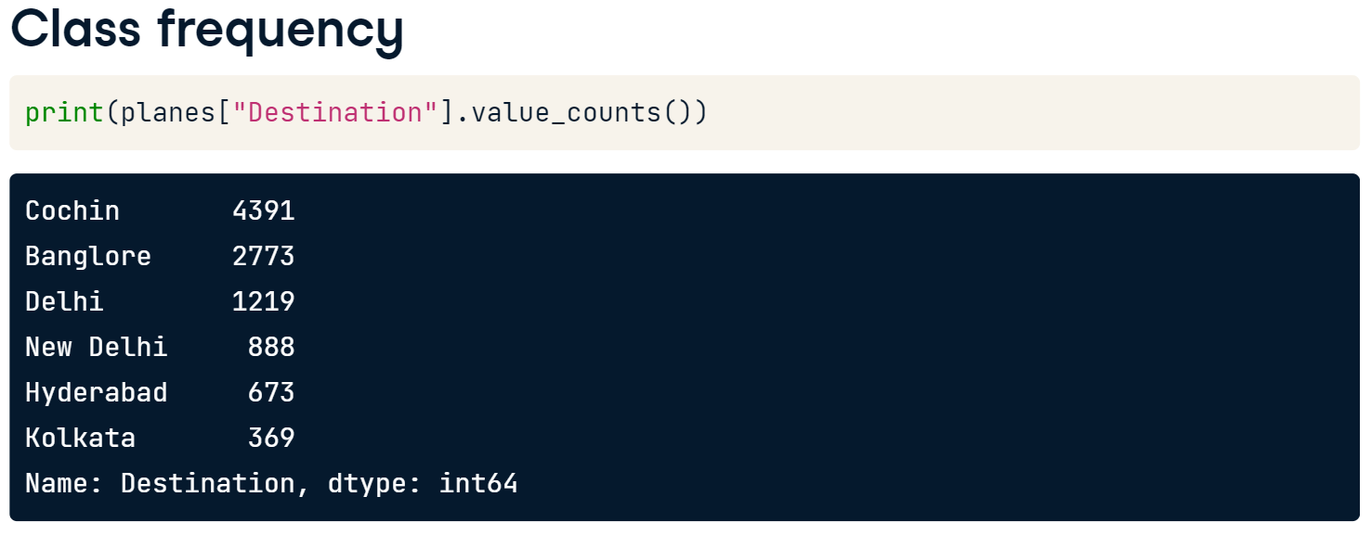
Class Frequency
Say that we know 40 percent of internal Indian flights go to Delhi. We can use the value_counts method again, but this time, set the normalize keyword argument equal to True. This returns the relative frequencies for each class, showing that Delhi only represents 11.82 percent of destinations in our dataset. Again, this could suggest that our data is not representative of the population - in this case, internal flights in India.

Slide 30
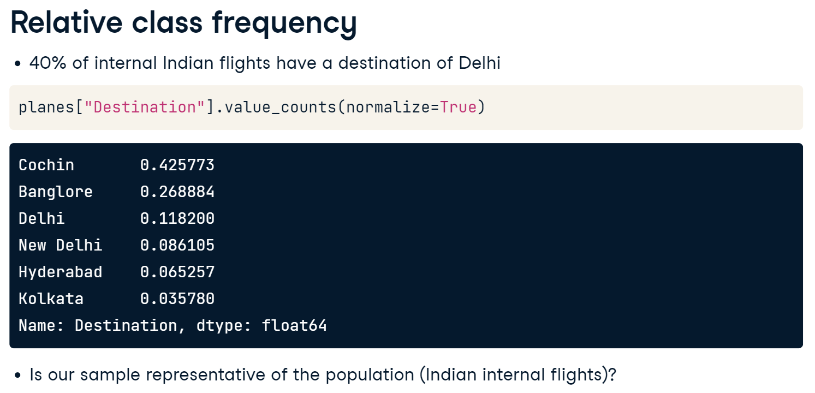

Slide 31
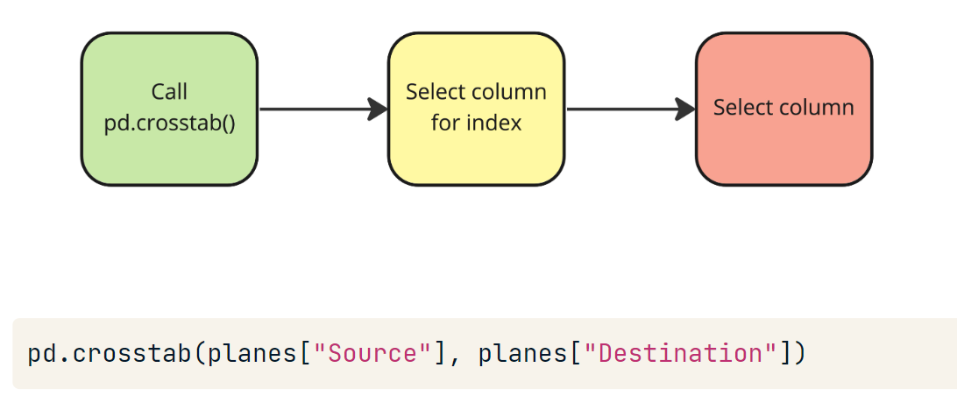
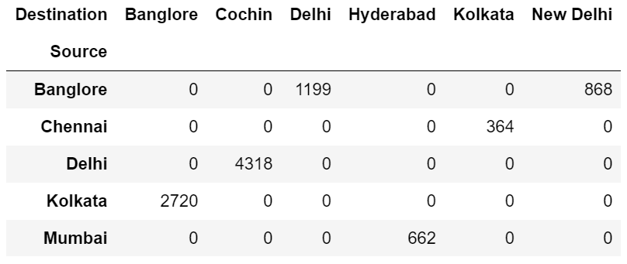
Checking Class Frequency with Cross-tabulation
Another method for looking at class frequency is cross-tabulation, which enables us to examine the frequency of combinations of classes. Let's look at flight route frequencies. We'll start by calling pd.crosstab() function.
We see the most popular route is from Delhi to Cochin, making up 4318 flights.

Slide 32
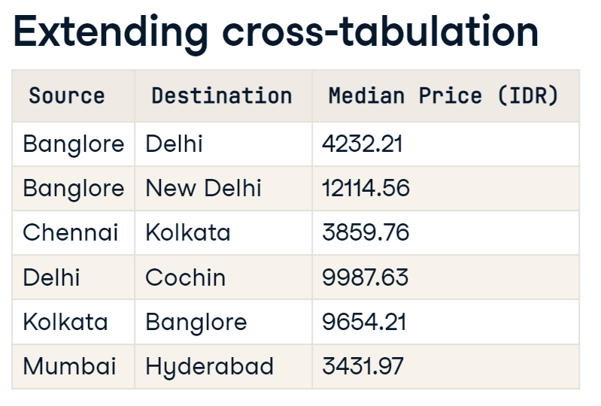
Say we know the median price for all internal flight routes in India. Here they are for the routes in our dataset, measured in Indian Rupees. We can calculate the median price for these routes in our DataFrame, and compare the difference to these expected values.
We do this by adding two keyword arguments to pd.crosstab(). We pass the Price column to the values= argument, and use aggfunc() to select what aggregated calculation we want to perform. We can pass a summary statistic as a string, in this case, setting it equal to the median. The results show median values for all possible routes in the dataset.

Slide 33
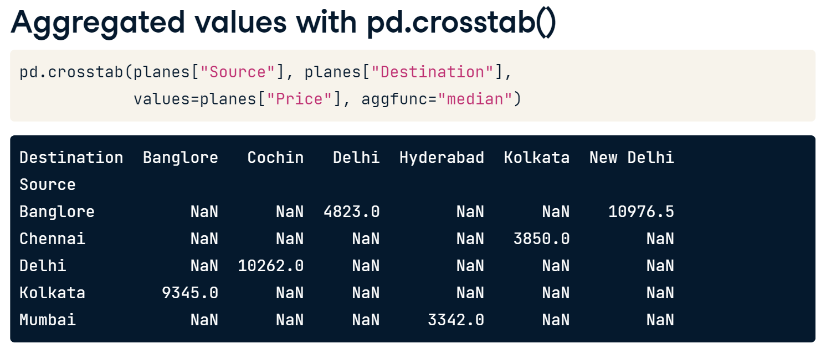
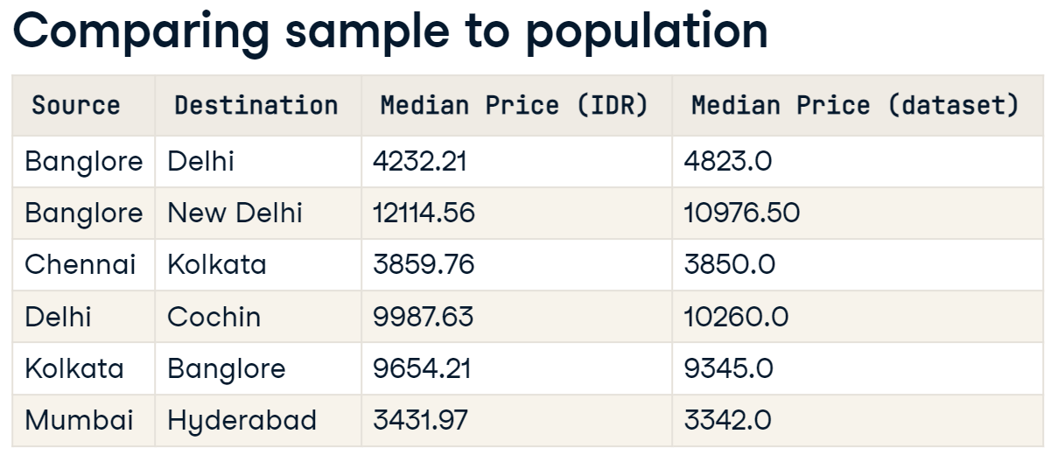
Comparing our prices with the expected values, most are similar. However, routes from Banglore to Delhi and New Delhi are significantly different (more expensive and less expensive) in the dataset, suggesting they aren't representative of the population.
Also try → planes.groupby(['Source','Destination']).median(numeric_only = True)

Slide 34
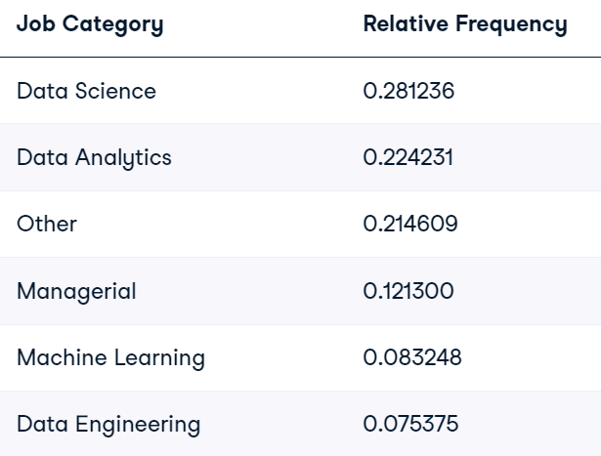
Let’s Practice
Checking for class imbalance
The 2022 Kaggle Survey captures information about data scientists' backgrounds, preferred technologies, and techniques. It is seen as an accurate view of what is happening in data science based on the volume and profile of responders.
Having looked at the job titles and categorized to align with our salaries DataFrame, you can see the following proportion of job categories in the Kaggle survey:
Load Salary_Rupee_USD.csv to salaries with index_col = 0
7. Print the relative frequency of the "Job_Category" column from salaries DataFrame.
Note: It looks like Data Science is the most popular class and has a similar representation. Still, the other categories have quite different relative frequencies, which might not be surprising given the target audience is data scientists! Given the difference in relative frequencies, can you trust the salaries DataFrame to accurately represent Managerial roles?

Slide 35
Let’s Practice
Cross-tabulation
Cross-tabulation can help identify how observations occur in combination.
Using the salaries dataset, you'll perform cross-tabulation on multiple variables, including the use of aggregation, to see the relationship between "Company_Size" and other variables.
8. Perform cross-tabulation, setting "Company_Size" as the index, and the columns to classes in "Experience".
Perform cross-tabulate "Job_Category" and classes of "Company_Size" as column names.
Update pd.crosstab() to return the mean "Salary_USD" values.
Note: Looks like the largest mean salary is for Managerial data roles in large companies!

Slide 36
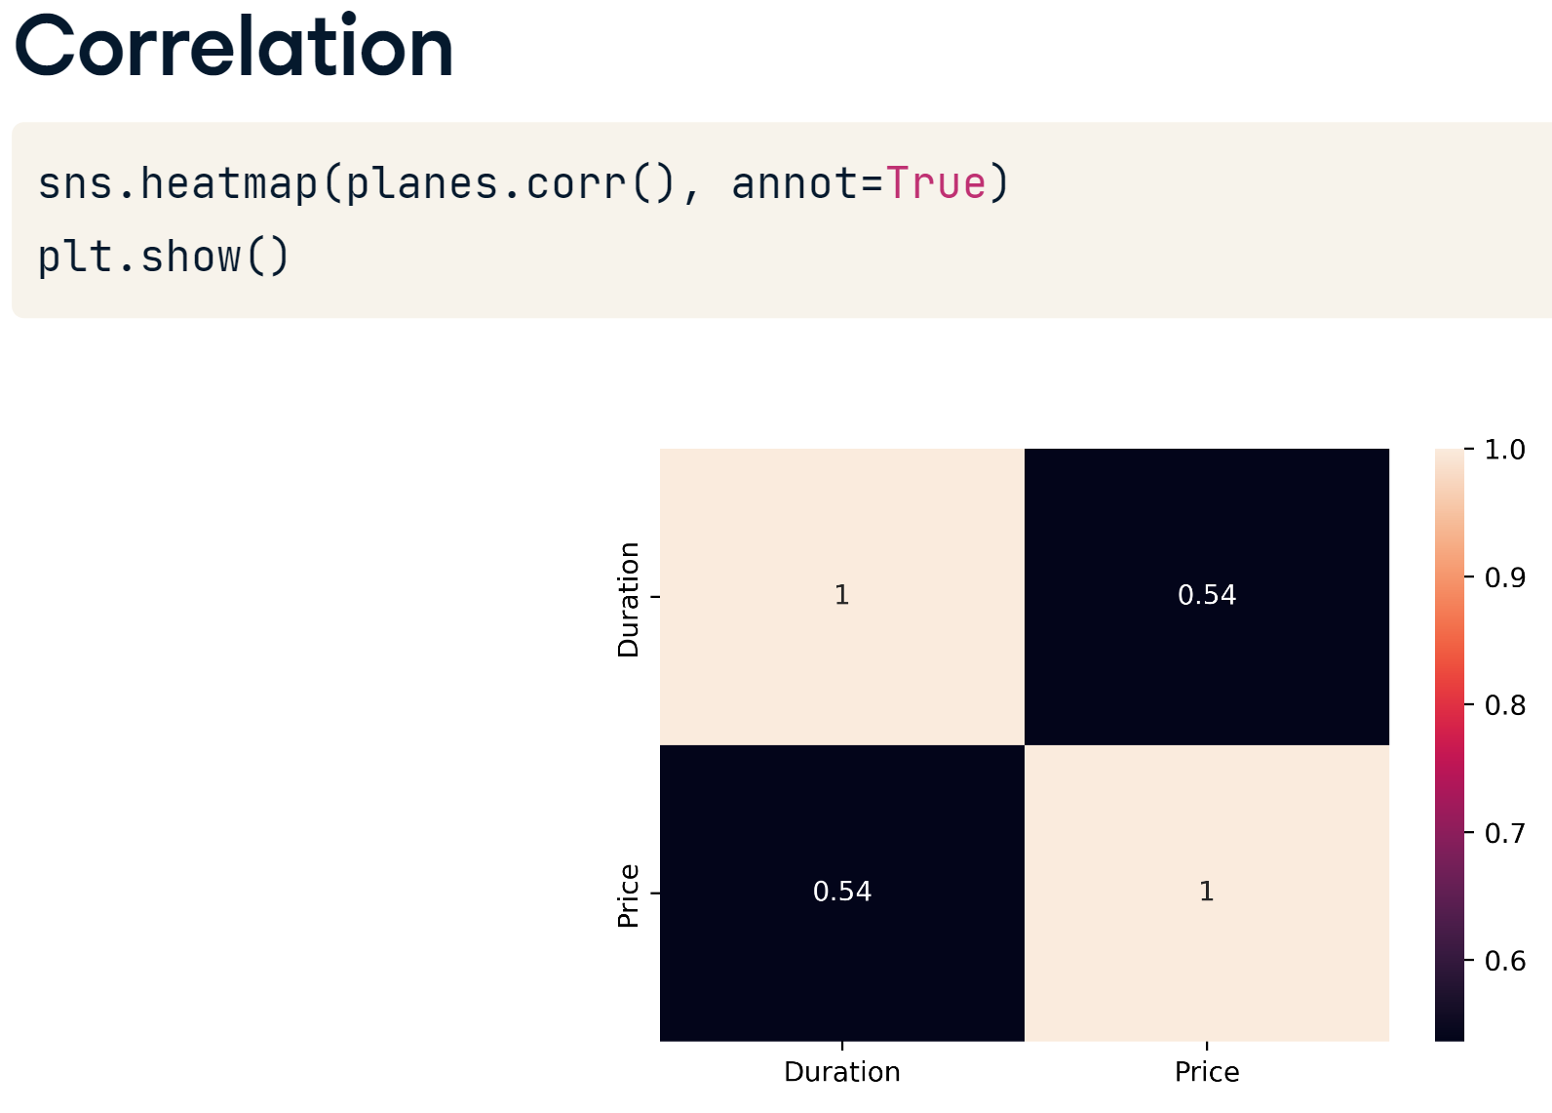
Generating New Features
Sometimes the format of our data can limit our ability to detect relationships or inhibit the potential performance of machine learning models. One method to overcome these issues is to generate new features from our data!
Checking correlation with a heatmap, we see a moderate positive correlation between Price and Duration, but it looks like those are the only numeric variables in our dataset.

Slide 37
planes = pd.read_csv('Airlines_unclean.csv', index_col = 0, \
parse_dates=['Date_of_Journey','Dep_Time','Arrival_Time’], date_format = "%d/%m/%Y" )
# Remove the string character
planes["Duration"] = planes["Duration"].str.replace("h", ".")
planes["Duration"] = planes["Duration"].str.replace("m", "")
planes["Duration"] = planes["Duration"].str.replace(" ", "")
# Convert to float data type
planes["Duration"] = planes["Duration"].astype(float)
print(planes.info())
ax = sns.heatmap(planes.corr(numeric_only = True), annot=True)
ax.set_ylim([0,2])
plt.show()

Slide 38
Note:
Depending on the version you are using, if parse_dates() cannot convert all provided columns to date_time format. You might need to parse the wanted column individually.
planes['Arrival_Time'] = pd.to_datetime(planes['Arrival_Time'], format = "%d/%m/%Y %H:%M", errors='coerce’)
planes['Dep_Time'] = pd.to_datetime(planes['Dep_Time'], format = "mixed")
print(planes.dtypes)
print(planes.head())
In the pandas.to_datetime() function, setting errors='coerce' instructs pandas to convert any values it cannot parse into a valid date/time format into NaT (Not a Time).
NaT is pandas' representation for a missing or null datetime value. This parameter is particularly useful for handling messy or inconsistent date data without the function raising an exception and stopping the entire program's execution.

Slide 39
#remove Nan values
threshold = len(planes) * 0.05
print(threshold)
# Count the number of missing values in each column
print(planes.isna().sum())
# Find the five percent threshold
threshold = len(planes) * 0.05
# Create a filter
cols_to_drop = planes.columns[planes.isna().sum() <= threshold]
# Drop missing values for columns below the threshold
planes.dropna(subset=cols_to_drop, inplace=True)
print(planes.isna().sum())
#planes = planes.drop(columns = ['Additional_Info’])
# Calculate median plane ticket prices by Airline
airline_prices = planes.groupby("Airline")["Price"].median()
print(airline_prices)
print('============================================‘)
# Convert to a dictionary
prices_dict = airline_prices.to_dict()
print(prices_dict)
print('============================================‘)
# Map the dictionary to missing values of Price by Airline
planes["Price"] = planes["Price"].fillna(planes["Airline"].map(prices_dict))
# Check for missing values
print(planes.isna().sum())

Slide 40
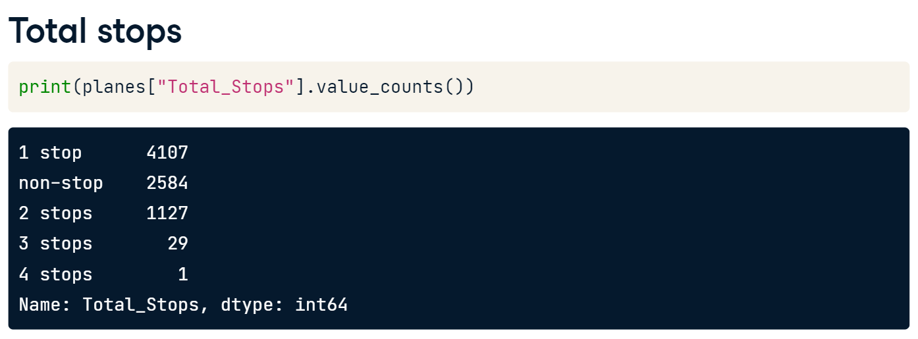
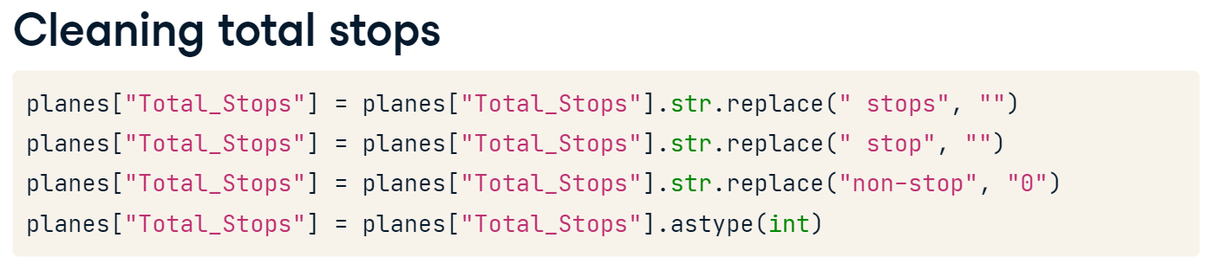
Total Stops
Viewing the data types confirms this is the case. However, Total_Stops should also be numeric. Viewing the value_counts, we see need to remove string characters.
We use the str.replace() method to first remove " stops", including the space, so that flights with two, three, or four stops are ready to convert. Next, we clean flights with one stop. Lastly, we change "non-stop" to "0", then set the data type to integer.

Slide 41
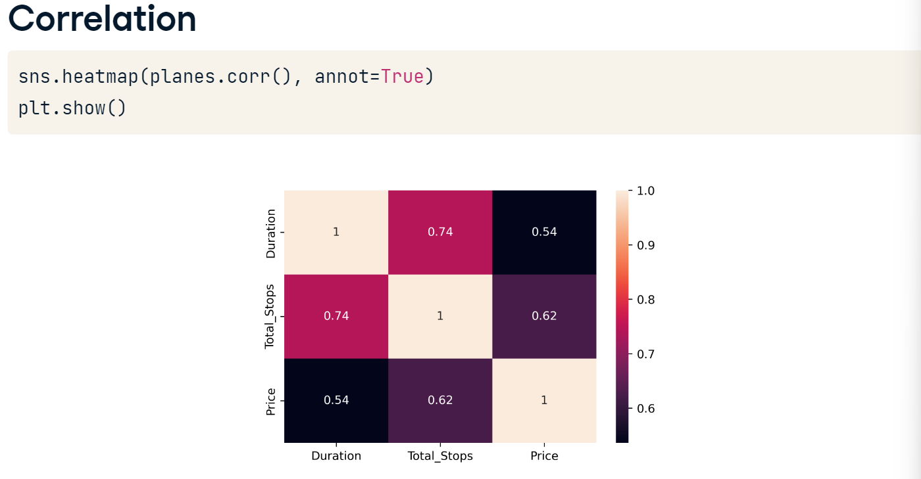
Unsurprisingly, Total_Stops is strongly correlated with Duration. What is interesting is that Total_Stops and Price are more strongly correlated than Duration is with Price! Let's see what else we can find out!
Rechecking our data types, notice that there are three datetime variables - Date_of_Journey, Dep_Time, and Arrival_Time.
Don’t forget numeric_only = True argument.

Slide 42
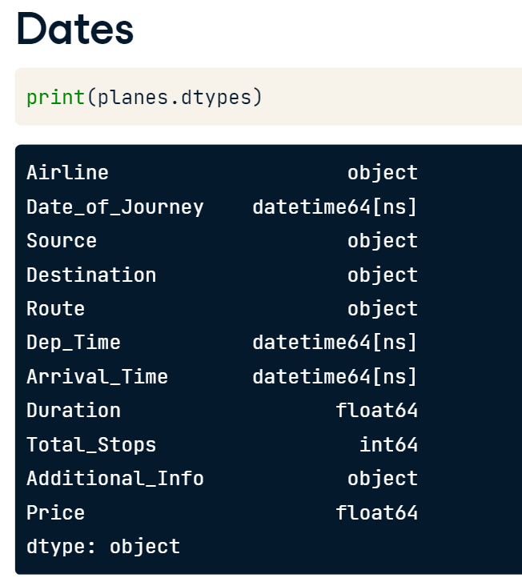
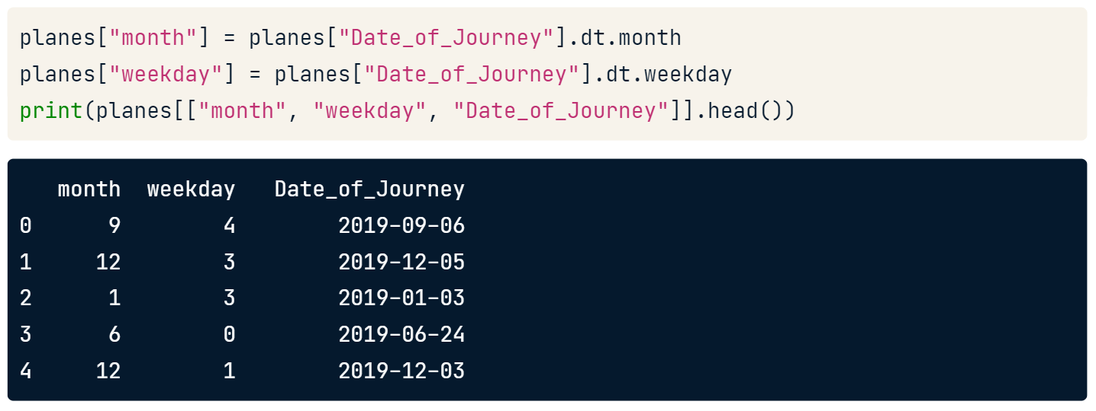
Extracting Months and Weekdays
We know how to extract attributes from datetime values, so we can see if these offer any insights into pricing. To start, let's look at Date_of_Journey. If we think prices vary per month, it's worth using this attribute - we create it as a column in our DataFrame.
Perhaps prices might also differ depending on the day of the week? Let's grab that using the dt.weekday attribute. It returns values of zero, representing Monday, through to seven, for Sunday.
Previewing these columns we see the first flight, departing on the 6th September, was a Friday, indicated by a four.

Slide 43
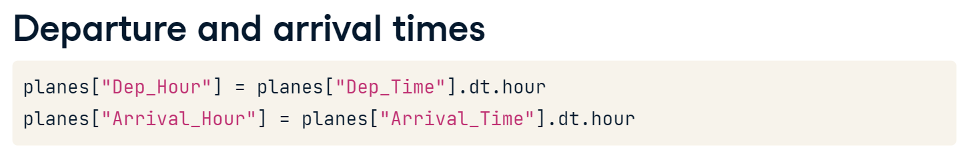
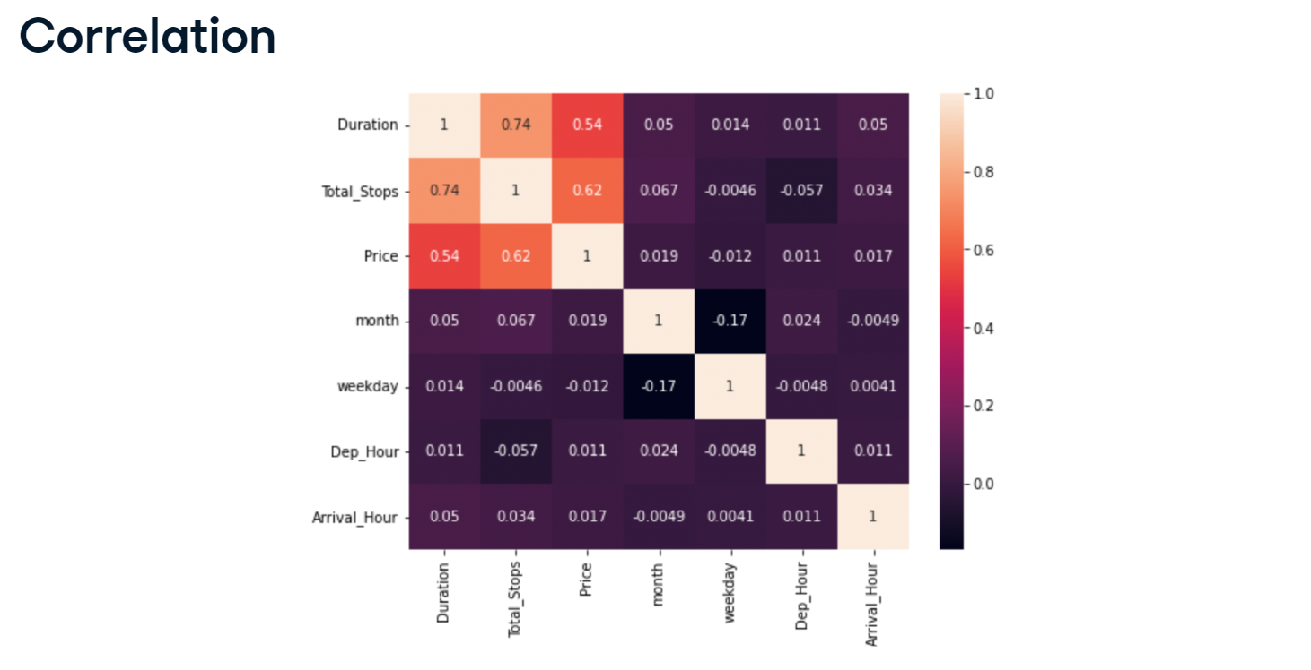
We might wonder if people tend to pay more to depart or arrive at more convenient times. We extract the hour of departure and arrival from those respective columns too.
Because they are numeric, we can calculate correlation between these new datetime features and other variables. Re-plotting our heatmap, unfortunately there aren't any new strong relationships. But we wouldn't have known this if we hadn't generated these features.
Note: If the data type of ’Dep_Time’ and ‘Arrival_Time’ is not DateTime format, you must change their data type to DateTime format.’
For instance, planes['Dep_Time'] = pd.to_datetime(planes['Dep_Time'], format='mixed')

Slide 45
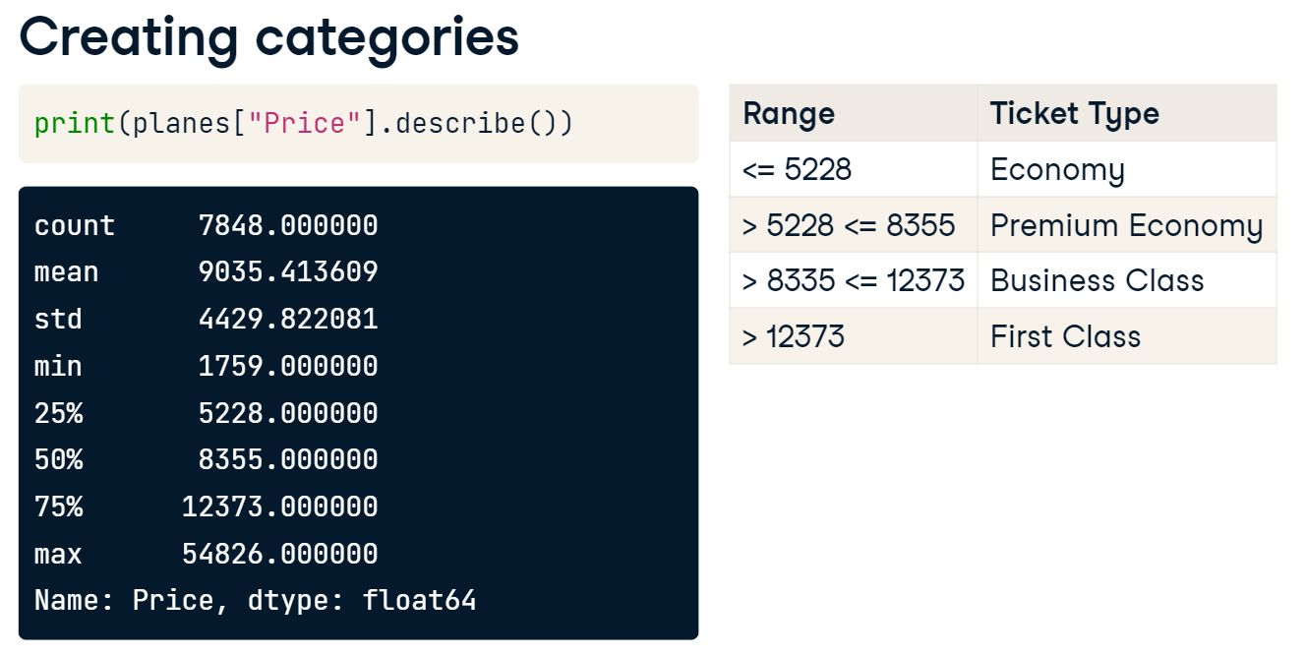
Another Technique to Generate New Features
There’s another technique we can use to generate new features. We can group numeric data and label them as classes. For example, we don't have a column for ticket type. We could use descriptive statistics to label flights as economy, premium economy, business class, or first class, based on prices within specific ranges, or bins.
We'll split equally across the price range using quartiles. We first store the 25th percentile using the quantile method. We get the 50th percentile by calling the median. Next we get the 75th percentile, and lastly, we store the maximum value.

Slide 46
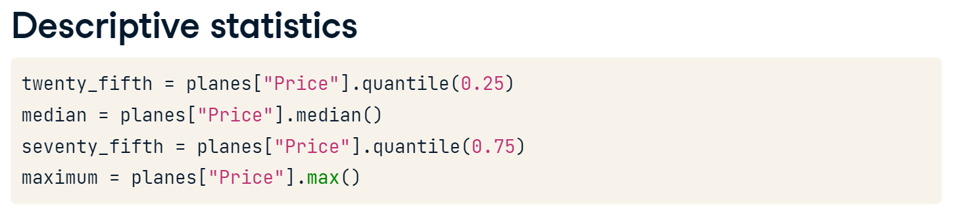
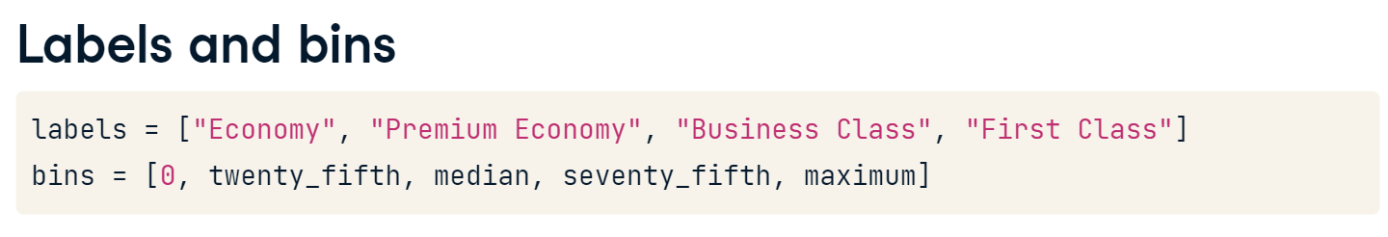
Then create labels. Next, we create the bins, a list starting from zero and including our descriptive statistic variables.

Slide 47
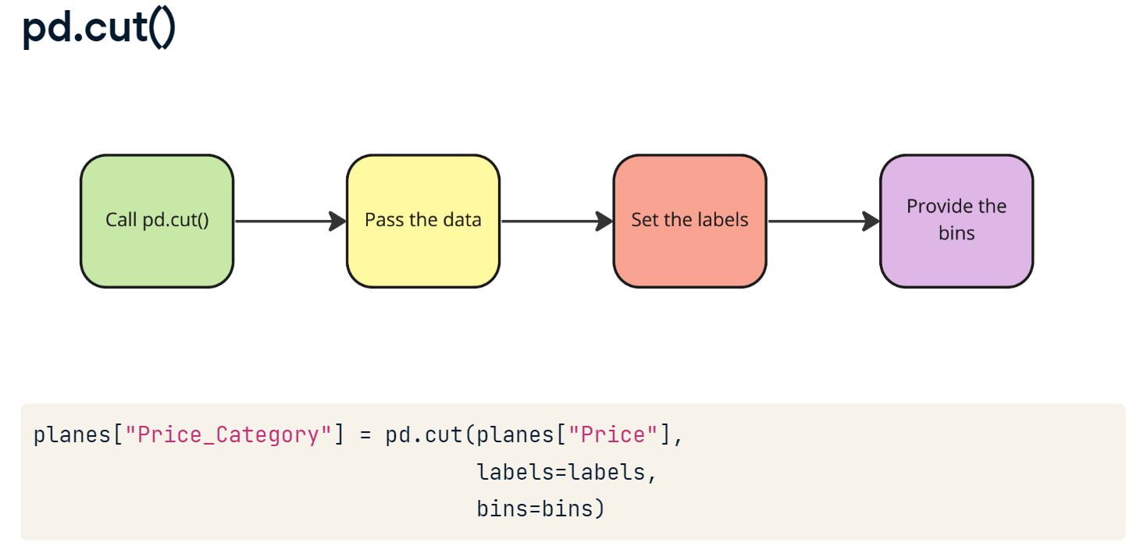
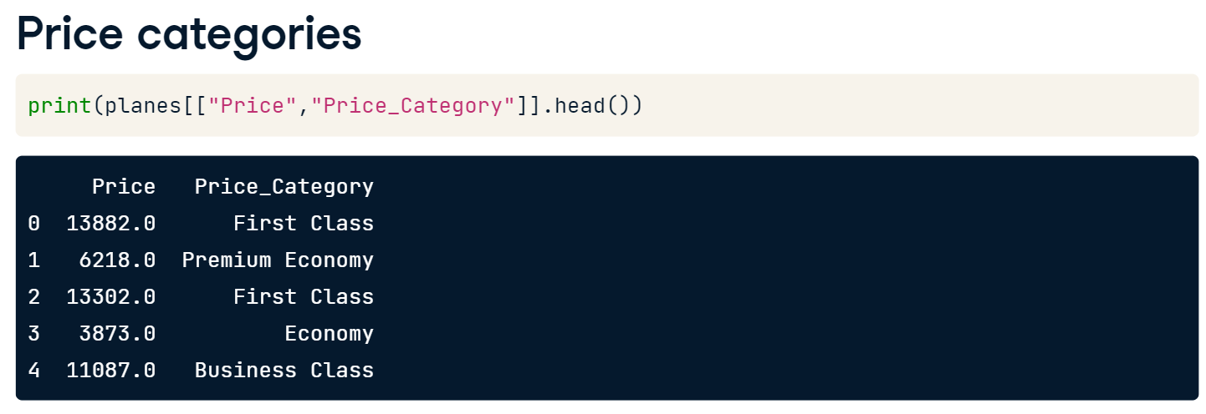
Then preview the price categories.

Slide 48
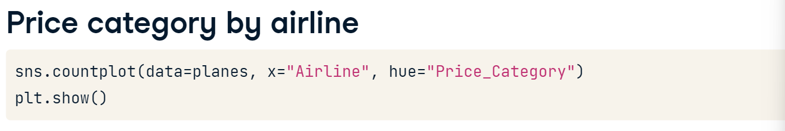
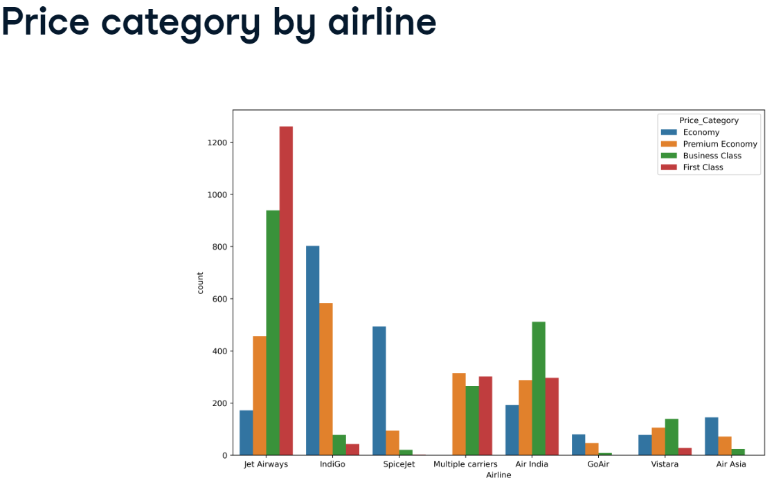
It looks like Jet Airways has the largest number of "First Class" tickets, while most of IndiGo and SpiceJet's flights are "Economy."

Slide 49
Let’s Practice
Load the Salaries_with_date_of_response.csv to salaries, with index_col = 0 and parse_date = [‘date_of_response’]
Your task is to extract datetime attributes from this column and then create a heat map to visualize the correlation coefficients between variables.
9. Extract the month from "date_of_response", storing it as a column called "month".
Create the "weekday" column, containing the weekday that the participants completed the survey.
Plot a heat map, including the Pearson correlation coefficient scores.
Your next task is to convert the "Salary_USD" column into categories based on its percentiles. First, you need to find the percentiles and store them as variables. (See next slide)

Slide 50
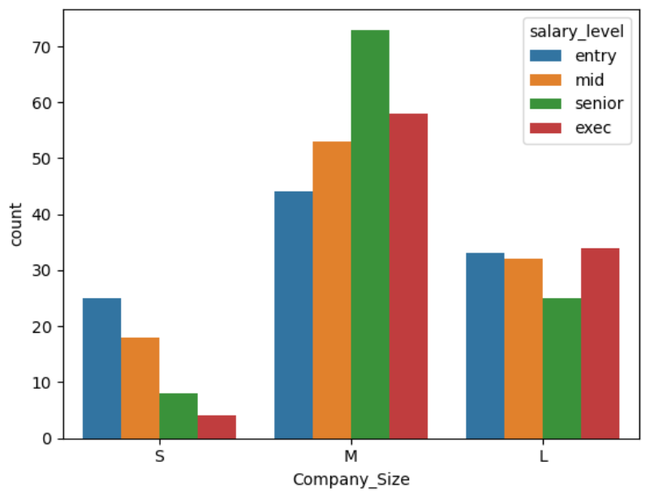
10. Find the 25th percentile of "Salary_USD".
- Store the median of "Salary_USD" as salaries_median.
- Get the 75th percentile of salaries.
- Create salary_labels, a list containing "entry", "mid", "senior", and "exec".
- Finish salary_ranges, adding the 25th percentile, median, 75th percentile, and largest value from "Salary_USD"
- Split "Salary_USD" based on the labels and ranges you've created.
- Use sns.countplot() to visualize the count of "Company_Size", factoring salary level labels.

Slide 51


11. Regarding comparing salaries, exploratory data analysis is a crucial step in generating hypotheses! You've had an idea you'd like to explore—do data professionals get paid more in the USA than they do in Great Britain? You'll need to subset the data by "Employee_Location" and produce a plot displaying the average salary between the two groups.
- Filter salaries where "Employee_Location" is "US" or "GB", saving as usa_and_gb.
- Use usa_and_gb to create a barplot visualizing "Salary_USD" against "Employee_Location".
- Create a bar plot of salary versus company size, factoring in employment status (hue)

Slide 52
Notes to Take
How can correlation help your business?
Correlation is widely used in real-life decision-making. You will find correlations in Marketing, Finance, and Sales. Basically, we could mention domains endlessly.
A few benefits:
Pattern recognition. Looking at millions of rows of raw data in the big data world will not tell you anything about the business. Using existing information for better decision-making will be crucial in the future. It can reveal new business opportunities, give insights about existing processes, and help to communicate clearly. Recognizing patterns is one of data science’s main goals, and correlation analysis can help with that.
Financial decision making – investment decisions. Diversifying is essential. Investing in negatively correlated sectors can help you mitigate risk.
For example: if the airline industry is negatively correlated with the social media industry, the investor may choose to invest in a social media stock. If a negative event affects one of those industries, the other sector will be a safer place for the money.
Projections. If a company finds a positive correlation between two variables and has some predictions on the one variable involved in the correlation, it can also try to make predictions on the second variable.
For example, Company X finds a positive correlation between the number of tourists in City Y and its sales. A 10% rise in visitors for the coming year is predicted in city Y. Company X can also anticipate an increase in sales. Of course, one should always consider the above-mentioned correlation-causation issue when it comes to predictions.

